Slide 1
教會與拉丁語
Greek ➾ Latin ➾ local languages,
Biblia Vulgata
scribes - Charlesmagne
universities
Gregorian Chants - pronunciation,Pius XI, 1922-1939Pope Pius XII, (1876-1958)John XXIII, 1958-1963《禮儀》憲章 1963Pope Paul VI, Sacrificium Laudis, 1966John Paul II, 1978天主教法典 1983Benedict XVI, 2007

Slide 3
papal coat of arms

Slide 4
papal coat of arms

Slide 5
papal resignation
http://www.youtube.com/watch?v=g-NJNSBNsyk&feature=share&list=PLJnf_DDTfIVCV0y0Bu6UxtO9_4fOUREba

Slide 6
Fratres carissimi
Non solum propter tres canonizationes ad hoc Consistorium vos convocavi, sed etiam ut vobis decisionem magni momenti pro Ecclesiae vita communicem. Conscientia mea iterum atque iterum coram Deo explorata ad cognitionem certam perveni vires meas ingravescente aetate non iam aptas esse ad munus Petrinum aeque administrandum.
Bene conscius sum hoc munus secundum suam essentiam spiritualem non solum agendo et loquendo exsequi debere, sed non minus patiendo et orando. Attamen in mundo nostri temporis rapidis mutationibus subiecto et quaestionibus magni ponderis pro vita fidei perturbato ad navem Sancti Petri gubernandam et ad annuntiandum Evangelium etiam vigor quidam corporis et animae necessarius est, qui ultimis mensibus in me modo tali minuitur, ut incapacitatem meam ad ministerium mihi commissum bene administrandum agnoscere debeam. Quapropter bene conscius ponderis huius actus plena libertate declaro me ministerio Episcopi Romae, Successoris Sancti Petri, mihi per manus Cardinalium die 19 aprilis MMV commisso renuntiare ita ut a die 28 februarii MMXIII, hora 20, sedes Romae, sedes Sancti Petri vacet et Conclave ad eligendum novum Summum Pontificem ab his quibus competit convocandum esse.
Fratres carissimi, ex toto corde gratias ago vobis pro omni amore et labore, quo mecum pondus ministerii mei portastis et veniam peto pro omnibus defectibus meis. Nunc autem Sanctam Dei Ecclesiam curae Summi eius Pastoris, Domini nostri Iesu Christi confidimus sanctamque eius Matrem Mariam imploramus, ut patribus Cardinalibus in eligendo novo Summo Pontifice materna sua bonitate assistat. Quod ad me attinet etiam in futuro vita orationi dedicata Sanctae Ecclesiae Dei toto ex corde servire velim.
Ex Aedibus Vaticanis, die 10 mensis februarii MMXIII

Slide 7
Fratres carissimi
Non solum propter tres canonizationes ad hoc Consistorium vos convocavi, sed etiam ut vobis decisionem magni momenti pro Ecclesiae vita communicem. Conscientia mea iterum atque iterum coram Deo explorata ad cognitionem certam perveni vires meas ingravescente aetate non iam aptas esse ad munus Petrinum aeque administrandum.
Bene conscius sum hoc munus secundum suam essentiam spiritualem non solum agendo et loquendo exsequi debere, sed non minus patiendo et orando. Attamen in mundo nostri temporis rapidis mutationibus subiecto et quaestionibus magni ponderis pro vita fidei perturbato ad navem Sancti Petri gubernandam et ad annuntiandum Evangelium etiam vigor quidam corporis et animae necessarius est, qui ultimis mensibus in me modo tali minuitur, ut incapacitatem meam ad ministerium mihi commissum bene administrandum agnoscere debeam. Quapropter bene conscius ponderis huius actus plena libertate declaro me ministerio Episcopi Romae, Successoris Sancti Petri, mihi per manus Cardinalium die 19 aprilis MMV commisso renuntiare ita ut a die 28 februarii MMXIII, hora 20, sedes Romae, sedes Sancti Petri vacet et Conclave ad eligendum novum Summum Pontificem ab his quibus competit convocandum esse.
Fratres carissimi, ex toto corde gratias ago vobis pro omni amore et labore, quo mecum pondus ministerii mei portastis et veniam peto pro omnibus defectibus meis. Nunc autem Sanctam Dei Ecclesiam curae Summi eius Pastoris, Domini nostri Iesu Christi confidimus sanctamque eius Matrem Mariam imploramus, ut patribus Cardinalibus in eligendo novo Summo Pontifice materna sua bonitate assistat. Quod ad me attinet etiam in futuro vita orationi dedicata Sanctae Ecclesiae Dei toto ex corde servire velim.
Ex Aedibus Vaticanis, die 10 mensis februarii MMXIII

Slide 8
Greek ➾ Latin ➾ local languages,
Biblia Vulgata
scribes - Charlesmagne
universities
Gregorian Chants - pronunciation,

Slide 9
Pius XI, 1922-1939
Apostolic Letter “Officiorum omnium”, 1922.
"For the Church, precisely because it embraces all nations and is destined to endure to the end of time ... of its very nature requires a language which is universal, immutable, and non-vernacular."

Slide 10
Pope Pius XII, (1876-1958)
Mediator Dei, 1947
"60. The use of the Latin language, customary in a considerable portion of the Church, is a manifest and beautiful sign of unity, as well as an effective antidote for any corruption of doctrinal truth. In spite of this, the use of the mother tongue in connection with several of the rites may be of much advantage to the people. But the Apostolic See alone is empowered to grant this permission."

Slide 11
John XXIII, 1958-1963
Apostolic Constitution Veterum sapientia, 1962
5. universal
6. immutable
7. non-vernacular
http://rorate-caeli.blogspot.com/2012/02/mcmlxii-veterum-sapientia-mmxii-solemn.html

Slide 12
Universal 普世5. Since "every Church must assemble round the Roman Church," and since the Supreme Pontiffs have "true episcopal power, ordinary and immediate, over each and every Church and each and every Pastor, as well as over the faithful" of every rite and language, it seems particularly desirable that the instrument of mutual communication be uniform and universal, especially between the Apostolic See and the Churches which use the same Latin rite.When, therefore, the Roman Pontiffs wish to instruct the Catholic world, or when the Congregations of the Roman Curia handle matters or draw up decrees which concern the whole body of the faithful, they invariably make use of Latin, for this is a maternal voice acceptable to countless nations.

Slide 13
Immutable 不變6. Furthermore, the Church's language must be not only universal but also immutable. Modern languages are liable to change, and no single one of them is superior to the others in authority. Thus if the truths of the Catholic Church were entrusted to an unspecified number of them, the meaning of these truths, varied as they are, would not be manifested to everyone with sufficient clarity and precision. There would, moreover, be no language which could serve as a common and constant norm by which to gauge the exact meaning of other renderings.But Latin is indeed such a language. It is set and unchanging. it has long since ceased to be affected by those alterations in the meaning of words which are the normal result of daily, popular use. Certain Latin words, it is true, acquired new meanings as Christian teaching developed and needed to be explained and defended, but these new meanings have long since become accepted and firmly established.

Slide 14
Non-vernacular 非方言7. Finally, the Catholic Church has a dignity far surpassing that of every merely human society, for it was founded by Christ the Lord. It is altogether fitting, therefore, that the language it uses should be noble, majestic, and non-vernacular.In addition, the Latin language "can be called truly catholic." It has been consecrated through constant use by the Apostolic See, the mother and teacher of all Churches, and must be esteemed "a treasure ... of incomparable worth.". It is a general passport to the proper understanding of the Christian writers of antiquity and the documents of the Church's teaching. It is also a most effective bond, binding the Church of today with that of the past and of the future in wonderful continuity.

Slide 15
梵蒂岡第二屆大公會議文獻《禮儀》憲章 196336 在拉丁禮儀內，除非有特殊法律規定，應保存使用拉丁語。54 在民眾參與的彌撒內，可准予相當部分的本地語言，尤其在讀經及信友禱詞部分，以及按照地方情形，根據本憲章第 36 的規定，屬於民眾的部分。但要設法，使信友們也能用拉丁文共同誦念成歌唱，彌撒常用經文中屬於他們的部分。

Slide 16
Pope Paul VI, Sacrificium Laudis, 1966
"The Latin language is assuredly worthy of being defended with great care instead of being scorned; for the Latin Church it is the most abundant source of Christian civilization and the richest treasury of piety... we must not hold in low esteem these traditions of your fathers which were your glory for centuries."

Slide 17
John Paul II, 1978Ad iuvenes ergo imprimis convertimur, qui hac aetate, qua litterae Latinae et humanitatis studia multis locis, ut notum est, iacent, hoc veluti Latinitatis patrimonium, quod Ecclesia maxime aestimat, alacres accipiant oportet et actuosi frugiferum reddant. Noverint ii hoc Ciceronis effatum ad se quodam modo referri: "Non ... tam praeclarum est scire Latine, quam turpe nescire".

Slide 18
天主教法典 1983249條在司鐸培育計劃中，務使修士不只專心學習其本國語言，而且要通曉拉丁文，並對其陶成及執行牧靈任務所必需的或有益的外文，也應有適當的認識。928條使用拉丁文或其他語文舉行彌撒，惟禮儀書應為已依法批准者。

Slide 19
Benedict XVI, 2007
The Apostolic Letter “Summorum Pontificum” specified the circumstances in which priests of the Latin Church may celebrate Mass according to the "Missal promulgated by John XXIII in 1962" (the form known as the Tridentine Mass), and administer most of the sacraments in the form used before the liturgical reforms that followed the Second Vatican Council.The document replaced the motu proprio “Ecclesia Dei” of 1988, which allowed individual bishops to establish places where Mass could be said using the 1962 Missal. It granted greater freedom to use the Tridentine liturgy in its 1962 form, stating that all priests may freely celebrate Mass with the 1962 Missal privately, without having to ask for permission from anyone. It also provided that pastors (parish priests) and rectors of churches should willingly accept requests from stable groups who adhere to the preceding liturgical tradition ("ubi coetus fidelium traditioni liturgicae antecedenti adhaerentium continenter exsistit" - Article 5) for permission for a qualified priest to celebrate Mass for them using the 1962 Missal, and should "ensure that the welfare of these faithful harmonises with the ordinary pastoral care of the parish, under the guidance of the bishop". (the Society of St. Pius X.)Each Catholic priest of the Latin rite may use the Roman Missal published by Bl. Pope John XXIII in 1962, or the Roman Missal promulgated by Pope Paul VI in 1970, and may do so on any day with the exception of the Easter Triduum.
http://www.preces-latinae.org/thesaurus/Introductio/Popes.html

Slide 20
The principle reasons in favor of Latin as the official language of Catholic Church
By Raymond Taouk
(CATHOLIC APOLOGETICS INFORMATION, Australia)
1: The concern for dogmatic unity.
2: The concern for stability.
3: The concern for Tradition.
4: The concern for universality.
5: Latin has many linguistic qualities.
6:Variety of Languages is the result of Sin.
http://www.catholicapologetics.info/languages/why/latin.htm

Slide 21
modern fashion brands
and
old Latin sayings

Slide 25
Si deus est, unde malum?
Si non est, unde bonum?- Boethius (480-524)

Slide 26
sint ut sunt, aut non sint
- Lorenzo Ricci (1703-1775)
expulsion of Jesuits from Portugal in 1758,
from France in 1764from Spain in 1767
suppression of Jesuits
by Clement XIV in 1773

Slide 27
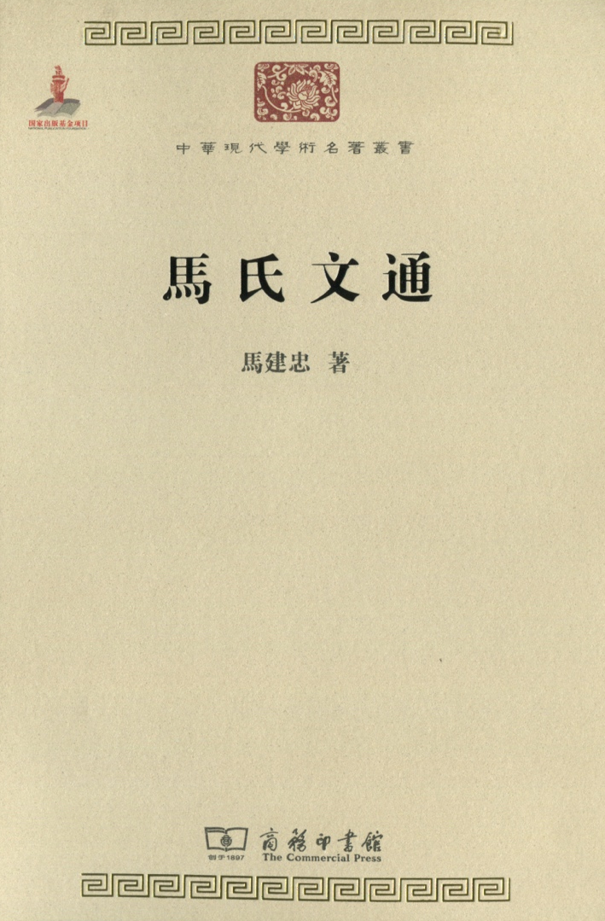
中華文化與拉丁語
馬建忠著的《馬氏文通》（1898年出版，）是中國關於漢語語法的第一部系統性著作，開建了中國的語法學。是馬建忠參照拉丁語法體系，及中國關於虛字的一些說法所創建的一套漢語語法體系。

Slide 28
中華文化與拉丁語
主題／主語
主格語／屈折語
孤立／綜合
語素／表音
教會／文化／語言

Slide 29
Ref:
Reginald Foster O.C.D. (born 1939 in Milwaukee, Wisconsin)
http://en.wikipedia.org/wiki/File:Reginald_Foster_in_Arpinum.jpg
Oxford Latin Dictionary
the Gildersleeve and Lodge Latin Grammar
http://thelatinlanguage.org/papal decrees

